Slide 1

Dealing with Data: Nuts & Bolts
J Foote, PhD

Slide 2



Data collection is like scuba diving……
Plan your dive, and dive your plan!

Slide 3
What is your aim?
What do you want to know?
What does it look like?

Slide 4
Who, what, when, where, why……
Target population - idiosyncrasies
1. Who
2. What
true/false, text (open ended), select from list,
3. When
date, time, day, season, time period
4. Why
What do you want to know – bottom line

Slide 5
Want to be thorough…..
clear
…but as minimally-invasive as possible

Slide 6
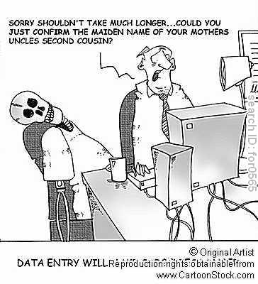

Slide 7

Let’s start by reviewing the types of data on can collect.

Slide 8
Data types: Key Terms
Categorical variables
Quantity variables
Nominal variables
Ordinal Variables
Binary data.
Discrete and continuous data.
Interval and ratio variables
Qualitative and Quantitative traits/ characteristics of data.

Slide 9
Categorical Data
The objects being studied are grouped into categories based on some qualitative trait.
The resulting data are merely labels or categories.

Slide 10
Examples: Categorical Data
Eye color: blue, brown, hazel, green, etc.
Newspapers: The Wildcat, Arizona Republic, New York Times, The Guardian, Wall Street Journal, Arizona Daily Star.
Smoking status: smoker, non-smoker, former smoker
Attitudes towards the death penalty:
Strongly disagree, disagree, neutral, agree, strongly agree.

Slide 11
Categorical data classified as Nominal, Ordinal, and/or Binary
Categorical data
Nominal
data
Ordinal
data
Binary
Not binary
Binary
Not binary

Slide 12
Nominal Data
A type of categorical data in which objects fall into unordered categories.

Slide 13
Examples: Nominal Data
Type of Bicycle
Mountain bike, road bike, chopper, folding, BMX.
Ethnicity
White British, Afro-Caribbean, Asian, Chinese, other, etc. (note problems with these categories).
Smoking status
smoker, non-smoker, former smoker

Slide 14
Ordinal Data
A type of categorical data in which order is important.
Class of degree-1st class, 2:1, 2:2, 3rd class, fail
Degree of illness- none, mild, moderate, acute, chronic.
Opinion of students about stats classes-
Very unhappy, unhappy, neutral, happy, ecstatic!

Slide 15
Binary Data
A type of categorical data in which there are only two categories.
Binary data can either be nominal or ordinal.
Attendance- present, absent
Class of mark- pass, fail.
Status of student- undergraduate, postgraduate.

Slide 16
Quantity Data
The objects being studied are ‘measured’ based on some quantitative trait.
The resulting data are set of numbers.

Slide 17
Examples: quantity Data
Pulse rate
Height
Age
Exam marks
Size of bicycle frame
Time to complete a statistics test
Number of cigarettes smoked

Slide 18
Quantity data can be classified as ‘Discrete or Continuous’
Quantity
data
Discrete
Continuous

Slide 19
Discrete Data
Only certain values are possible (there are gaps between the possible values). Implies counting.
Continuous Data
Theoretically, with a fine enough measuring device. Implies counting.

Slide 20
Discrete data -- Gaps between possible values- count
0 1 2 3 4 5 6 7
Continuous data -- Theoretically,
no gaps between possible values- measure
0 1000

Slide 21
Examples: Discrete Data
Number of children in a family
Number of students passing a stats exam
Number of crimes reported to the police
Number of bicycles sold in a day.
Generally, discrete data are counts.
We would not expect to find 2.2 children in a family or 88.5 students passing an exam or 127.2 crimes being reported to the police or half a bicycle being sold in one day.

Slide 22
Examples: Continuous data
Size of bicycle frame
Height
Time to run 500 metres
Age
‘Generally, continuous data come from measurements.
(any value within an interval is possible with a fine enough measuring device’- (Rowntree 2000)).

Slide 23
Relationships between Variables. (Source. Rowntree 2000: 33)
Variables
Category
Quantity
Continuous
(measuring)
Discrete
(counting)
Nominal
Ordinal
Ordered
categories
Ranks

Slide 24
Interval vs Ratio variables: Differences
According to Fielding & Gilbert (2000), terms often used interchangeably, & incorrectly by social scientists.
Interval: ordered categories, no inherent concept of zero (Clark 2004), we can calculate meaningful distance between categories, few real examples of interval variables in social sciences.
Ratio: A meaningful zero amount (eg income), possible to calculate ratios so also has the interval property (eg someone earning $80,000 earns twice as much as someone who earns $40,000).
Difference between interval and ratio usually not important for statistical analysis.

Slide 25
Interval variables- Examples
Fahrenheit temperature scale- Zero is arbitrary- 40 degrees is not twice as hot as 20 degrees.
IQ tests. No such thing as Zero IQ. 120 IQ not twice as intelligent as 60.
Question- Can we assume that attitudinal data represents real, quantifiable measured categories? (ie. That ‘very happy’ is twice as happy as plain ‘happy’ or that ‘Very unhappy’ means no happiness at all). Statisticians not in agreement on this.

Slide 26
Ratio variables-Examples
Can be discrete or continuous data.
The distance between any two adjacent units of measurement (intervals) is the same and there is a meaningful zero point (Papadopoulos 2001)
Income- someone earning $80,000 earns twice as much as someone who earns $40,000.
Height
Unemployment rate- measured as the number of jobseekers as a percentage of the labour force.

Slide 27
Why is this Important?
The type of data collected in a study determine the type of statistical analysis used.

Slide 28
So reviewed a bit about the types of data.
Now, here’s a brief summary about variables.

Slide 29
How Science works:
Variables

Slide 30
Learning Objectives
You should learn :
About the different types of variables,
How to identify them when doing your practical work.

Slide 31
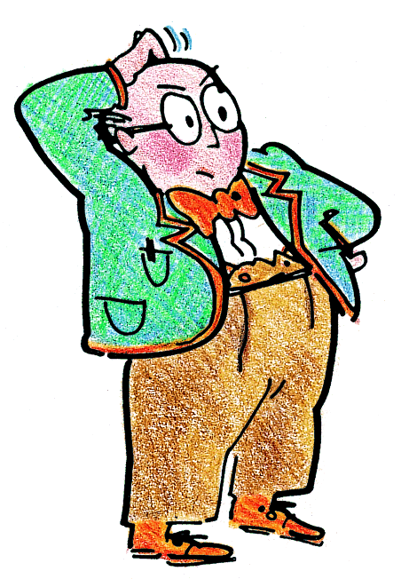
Variables
Variables are things that vary and change

Slide 32
Variables
In any experiment there are 3 variables:
an independent (or input) variable
a dependent (or outcome) variable
some control variables
Let’s look at each type….

Slide 33
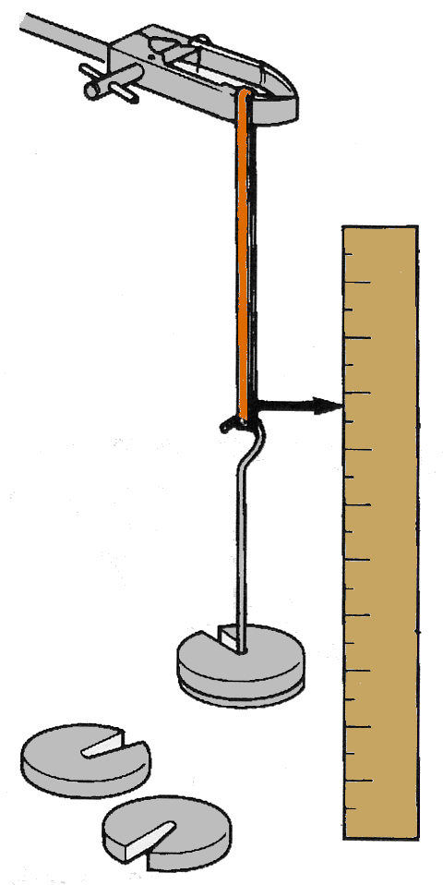
Independent (input) variable
This is the thing that you decide to change.
Example 1
Investigating how a weight affects the length of an elastic band.
You decide the weight to apply, so:
Weight is the independent variable.

Slide 34
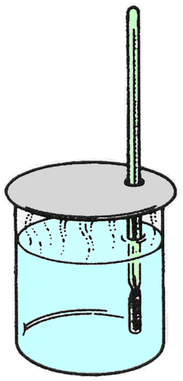
Independent (input) variable
This is the thing that you decide to change.
Example 2
Investigating how the rate of cooling of a beaker depends on the initial temperature.
You decide the initial temperature, so:
initial temperature is the independent variable.

Slide 35
Independent (input) variable
This is the thing that you decide to change.
Example 3
Investigating how a high fiber diet (> 30 gms/day ♀, or > 43 gms/day ♂) effects colon health.
Which is the independent variable you change in the lifestyle?
The dietary fiber is the independent variable.

Slide 36
Independent (input) variable
This is the thing that you decide to change.
Example 4
Investigating how providing flu shots freely to all students effects school attendance during Fall & Winter months (November - March.
Which is the independent variable you add?
The flu vaccine is the independent variable.

Slide 37
Dependent (outcome) variable
This is the variable that changes as a result. It is the variable that you measure.
Example 1
Investigating how a weight affects the length of an elastic band.
You measure the resulting length of the elastic band, so:
Length is the dependent variable.

Slide 38
Dependent (outcome) variable
This is the variable that changes as a result. It is the variable that you measure.
Example 2
Investigating how the rate of cooling of a beaker depends on the initial temperature.
You measure the temperature every minute as it cools, so:
temperature is the dependent variable.

Slide 39
Dependent (outcome) variable
This is the variable that changes as a result. It is the variable that you measure.
Example 3
Investigating how the colon health (regularity) is effected by consuming a high fiber diet.
Which is the dependent variable here?
The colon health (likely accessed by regularity) is the dependent variable.

Slide 40
Dependent (outcome) variable
This is the variable that changes as a result. It is the variable that you measure.
Example 4
Investigating how providing flu shots effects school attendance during the main flu season.
Which is the dependent variable here?
The school attendance record is the dependent variable.

Slide 41
Control variables
These are all the variables that must not change, to make sure it is a fair test.
Example 1
Investigating how a weight affects the length of an elastic band.
You must use the same elastic band all the time, and the same scale etc, so it is a fair test.

Slide 42
Control variables
These are all the variables that must not change, to make sure it is a fair test.
Example 2
Investigating how the rate of cooling of a beaker depends on the initial temperature.
You must use the same beaker, with the same amount of water, in the same position in the room, at the same room temperature, so it is a fair test.

Slide 43
Control variables
These are all the variables that must not change, to make sure it is a fair test.
Example 3
Investigating how a high fiber diet (> 30 gms/day ♀, or > 43 gms/day ♂) effects colon health.
Which are the control variables here?
Use the same population group in which intake of other macronutrients (protein, fat, carbohydrate) and activity levels are similar during each observation period of time.

Slide 44
Control variables
These are all the variables that must not change, to make sure it is a fair test.
Example 4
Investigating how providing flu shots effects school attendance during the main flu season
Which are the control variables here?
Either need to compare attendance records of the school to last year during flu season, or use a similar school in which you have assessed the proportion receiving flu shots (low %) as control. Potential exposure to the flu needs to be as similar as possible.

Slide 45

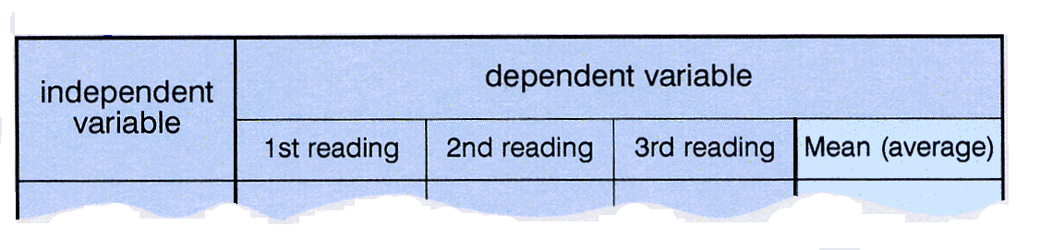
Tables
A good rule of thumb….
When you draw up a table of your results,
the independent variable goes in the first column, like this:
If you take several readings of the dependent variable, then you can calculate the mean (average)
Then your results will be more reliable.

Slide 46
In Summary
Example 1
The independent variable is ?
weight
The dependent variable is ?
length of the elastic
The control variables are ?
same elastic band, same scale, etc, so it is a fair test.

Slide 47
In Summary
Example 2
The independent variable is ?
initial temperature
The dependent variable is ?
temperature as it cools
The control variables are ?
the same beaker, with the same amount of water, in the same position in the room, at the same room temperature, so it is a fair test.

Slide 48
In Summary
Example 3
The independent variable is ?
high dietary fiber
The dependent variable is ?
colon health (regularity)
The control variables are ?
the same population, consuming similar diet with similar activity level, during the same length of time, so it is a fair test.

Slide 49
In Summary
Example 4
The independent variable is ?
flu shots
The dependent variable is ?
school attendance
The control variables are ?
The same months of comparison to prior year, or same months of a similar school in which students (mostly) did not receive flu shots.

Slide 50
Learning Outcomes
You should now:
Understand the difference between - independent, - dependent, and - control variables
Be able to identify these variables when doing your practical work.

Slide 51
Okay, so we talked a bit about the TYPES of data one can have, along with the kinds of VARIABLES in experimental settings.
We are going to continue the discussion by reviewing a bit about Data Management.

Slide 52
Data management-why is it important?
Data are the most important product of clinical research
The ability to record, store, manipulate, analyze, and retrieve data is critical to the research process
The influence of a clinical trial or registry in confirming new or evaluating existing treatments and making these treatments available for public consumption is wholly dependent on the the integrity of the data and the data collection process

Slide 53
What Are Data?
Information (facts /figures)
An accounting of the study

Slide 54
Data vs. information: What is the difference?
What is data?
Data can be defined in many ways. Information science defines data as unprocessed information.
What is information?
Information is data that have been organized and communicated in a coherent and meaningful manner.
Data is converted into information, and information is converted into knowledge.
Knowledge; information evaluated and organized so that it can be used purposefully.

Slide 55
What is the ultimate purpose of a database management system?
Is to transform
Data
Information
Knowledge
Action

Slide 56
Data management can and must originate early in the study design phase and end only when the last regulatory issue has been answered

Slide 57
“Classical” Data Management Flow in Research
Scientific Hypotheses
Specific Data Elements Required to Test Hypotheses
Data Acquisition Instruments (forms)
Computer Data Model and Tool Selection to Support Model and output to Analytical Software
People and Process Development
(Who does What, When and Where)
Documentation: Standard Operating Policies & Procedures

Slide 58
Data Management Process
Define data set, field names, codes
Data forms
Inspect data; hand edit
Enter data into computer
Data quality control
Check for missing, out-of range, illogical responses
Accumulate in database
Data quality control
Backups
Transfer to statistical and presentation software
Do statistical analysis
Prepare graphs
and tables

Slide 59
What is a database?
A database is a method of organizing and analyzing information.

Slide 60
Why use a database?
Organize and analyze information in different ways
Sorting
Grouping
Querying
Reporting
Exporting for statistical analysis
Computerized database
Speed
Quality control
Precision
Automate repetitive tasks

Slide 61
Databases versus Excel
Excel has some limited capabilities to sort data but its primary function is to create financial spreadsheets
Can create “what if” scenarios to determine financial consequences
Can be used for small & limited research data sets & simple lists
Not multi-user such that only one person can work on the file at a time
Databases are designed to collect, sort, and manipulate data
Data sets can process large amounts of data & is usually limited by hardware constraints
Structure is in the same format for each member record of a table
Data quality control features ensure that valid data is entered
A relational database allows for linking of an unlimited number of tables
Databases are multi-user because the data can reside on a server & multiple people can have access at the same time
Many databases offer web interfaces thereby eliminating the need for each user to have a copy of the the program on their computer

Slide 62
Databases versus Excel
Many databases offer audit functions required by certain regulatory agencies
Tracks date record created and modified
Tracks original and changed values
Requires user to give reason for the change
Databases are more suitable for importing data from multiple sources
More robust in connecting to different data sources
Imports of different data types into different tables can be linked via common identifiers such as subject ID
Merging multiple data sources into Excel so that the rows line up properly in a flat file format can be a challenge

Slide 63
How is a database organized?
One or more tables
Tables store records
Patient identifiers
Demographics and history
Test results
Etc…..
A record is a collection of fields
Patient identifiers
Name, DOB, address, …..are stored in separate fields

Slide 64
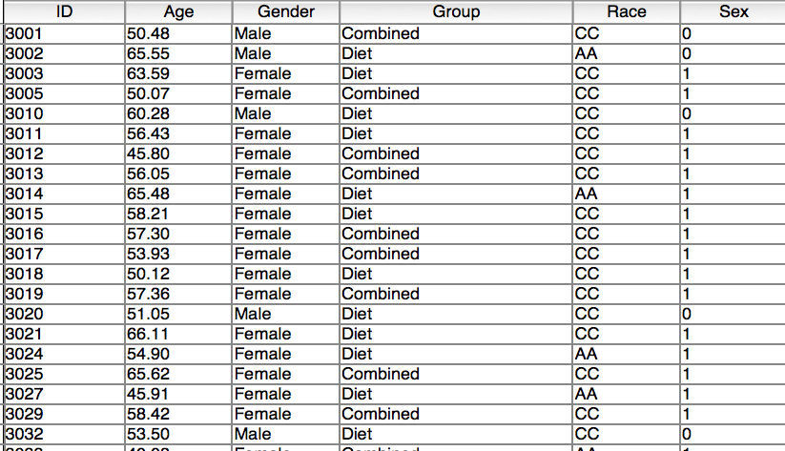
Records and Fields
Fields
Records

Slide 65
How is data displayed?
Fields are displayed on layouts
Forms
Web
Reports
Data can be from a single table or many tables if using a relational database

Slide 66
Relational Database Example
Subject Info
Anthropometrics
Id Name Age
10 Smith 50
11 Jones 55
12 Doe 60
ID Weight (lb) Weight (kg)
10 230 104.5
11 212 96.4
12 199 90.4
Physical Activity
Treadmill Performance
ID KCAL KCAL/kg
2400 23.1
2652 27.5
2350 25.9
ID V02 V02/kg
2.8 26.7
3.2 33.1
2.1 23.2

Slide 67
What is the difference between a clinical and research database?

Slide 68
Differences between a clinical and research database
Clinical database
Form or report oriented so data is displayed for clinical decision making
Emphasis on displaying or reporting of individual data rather than accumulating multiple records
Research database
Table oriented so that data is accumulated for eventual export to a statistical package for data analysis and reporting
Less emphasis on individual records

Slide 69
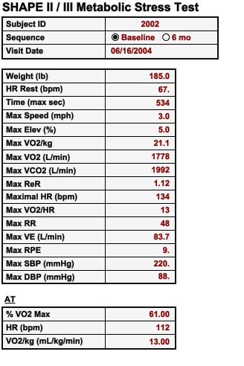
Example of a Clinical database:
The aim is to make decisions for the care of an individual patient.
Data is displayed so you can quickly see the individual patient’s results.

Slide 70
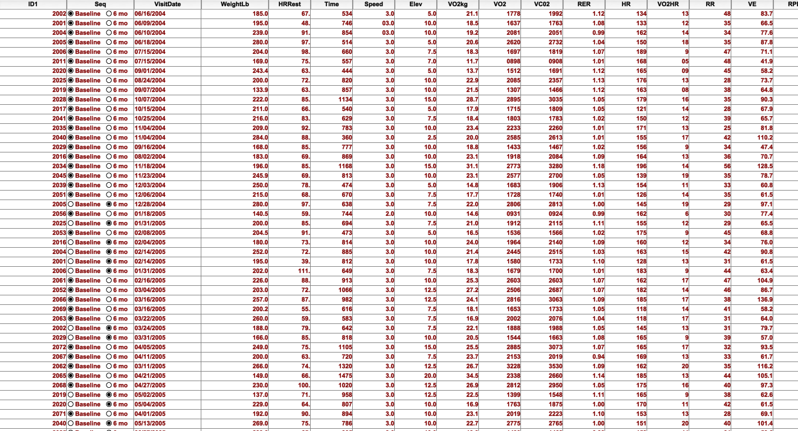
Example of Research Database: Summary of all participant results

Slide 71
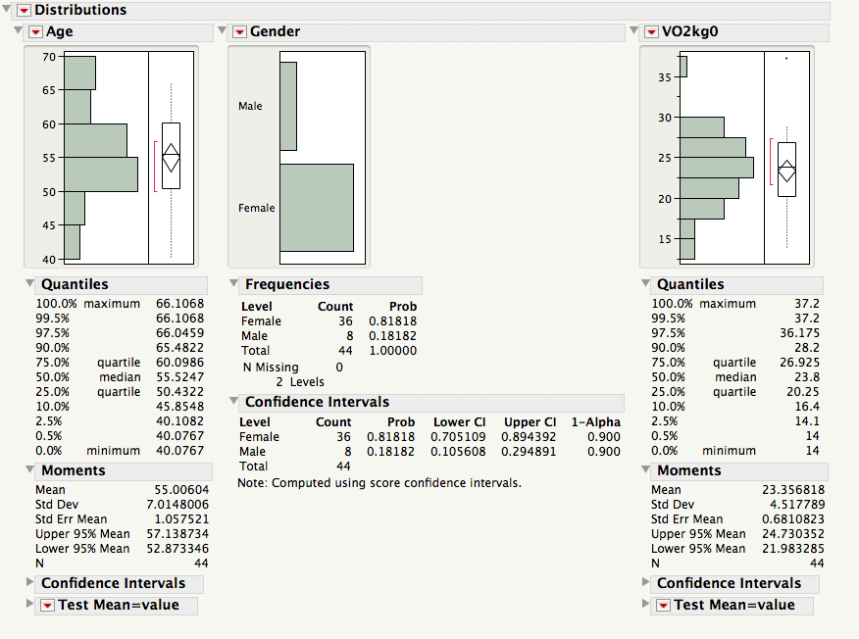
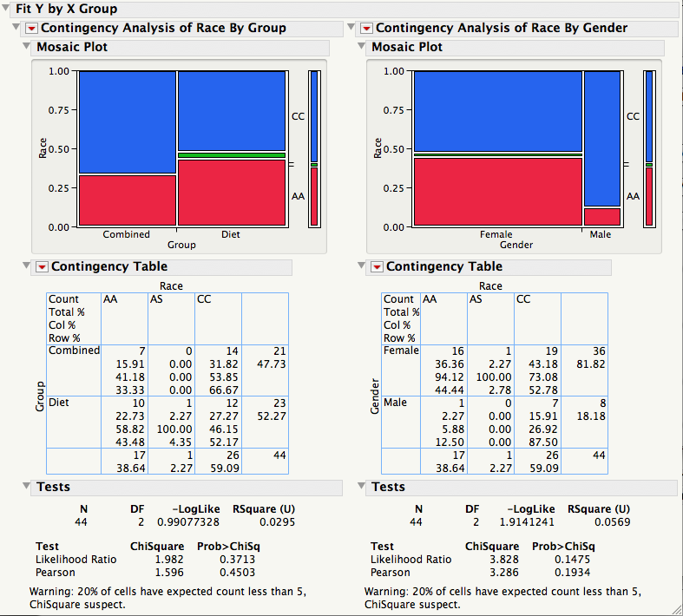
Research database allows quick analysis of the population.

Slide 72
Advantages of a database
Collection of data in a centralized location
Controls redundant data
Data stored so as to appear to users in one location
Data can be stored in multiple tables and come from multiple sources
A relational database brings it all together

Slide 73
Sharing and Exchanging Data
Multiple users can access the same database via a network
Can be local or over the internet
Best done when the data are stored on a database server
Access via a client application
Access via a web interface
Server allows remote access over the internet from anywhere
Should be behind a firewall for security with access via VPN and password protection

Slide 74
Database Design Considerations
What to collect
What questions are to be answered?
Think of the data tables in your future publications
Focus on the key data elements rather than collect as much as possible
What statistical package will be used
Format of the data file to which the data will be exported
Allowable characters
Format for certain analyses
For example, gender can be recorded in the database as M or F but statistical package may require 0 and 1
Length of data field labels
Long or wide format

Slide 75
So, way back at the beginning I said….
Data collection is like scuba diving……
Plan your dive, and dive your plan!

Slide 76
Quality Control of Data Before Study
…and here’s where we really start discussing how you collect data.
Collect only needed variables
Select appropriate computer hardware and software
Plan analyses with dummy tabulations
Develop study forms
Precode responses
Format boxes for data entry
Label each page with date, time, ID
Consider scan technology

Slide 77
What needs to be in the database?
Research variables directly related to the hypotheses being tested-YES
Clinical measures used for screening-MAYBE
Blood work, ECG, medical history
Administrative data-NO
Contact information
Scheduling

Slide 78
What Do You Do With the Data?
What you need in the database depends on:
Testing a hypothesis
Ongoing monitoring
Safety/adverse event reporting
Surveillance / assessing trends
IRB reports/sponsor reports
FDA reports
Early analysis/late analysis

Slide 79
Where Are the Original Data?
In the source documents

Slide 80
What is a Source Document?
It is the First Recording
What does it tell?
1. It is the data that document the trial
2. Study was carried out according to protocol

Slide 81
Source Documents
Surveys / questionnaires
Original Lab reports
Pathology/radiology reports & films
Surgical reports
Physician Progress Notes
Nurses Notes
Medical Record
Tumor measurements
Patient diary / patient interviews

Slide 82
Data-collection forms
Hard-copy
Require transcription, ideally double entry. No internal completeness/validity checks.
Allow marginalia, easy to version/adapt, audit archive
Scantron
Strict template, no marginalia, no internal validation
Must scan in real time, then backfill on-line via db
On-line forms
Allow real-time validity/completeness checks, prompts
Expensive, inflexible, need expertise and maintenance
Real-time vs asynchronous db connections (eg field surveys)
Risk losing primary documentation, audit archive
Versioning/record-locking is vital

Slide 83
Common Data Elements
Standardized, unique terms and phrases that delineate discrete pieces of information used to collect data in a clinical trial
Uniform representation of demographics and data points to consistently track trends
Elements define study parameters and endpoints

Slide 84
Designing the questions
Granular primary data
No observer conclusions, synthesis, coding
Categorical/ordinal data when possible—statistical power. Re-slice at analysis
Use validated scales/instruments
Don’t build your own unless unavoidable
Collect key variables with >1 question
Avoid measurements that cluster at one end of scale
Distribution problems, Likert scales
If questionnaire is self-administered, completer needs to have appropriate level of literacy, needs to be able to understand questions (terms) without help, easily able to follow questionnaire format, themes.

Slide 85
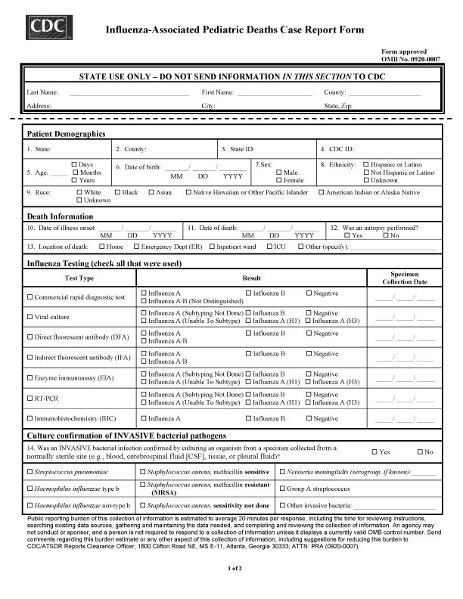
Forms Design example

Slide 86
Helpful hints: Form ergonomics/workflow
Don’t zigzag/over-compress
Long better than confusing
Major risks: Omitted data, inconsistent data
Prominent versioning (in header)
Pilot the form for 10-20 patients, then revise
Small studies: Anticipate variability

Slide 87
Operations Manual Note: EVERY study should include a clear, specific protocol, that includes sufficient detail that a new staff member could replicate approach & results exactly after reviewing the manual.
Defines entire study protocol, sequence
Form-specific annotation, guidance
Documents all post-hoc validity checks, edit checks, data curation criteria
Evolving document with periodic updates
Preferably on-line
Use for training, quality control, process planning

Slide 88
Data Dictionary (I)-Operational
Again, this is an imperative. Every study should have a clear, specific Data Dictionary that is designed PRIOR to data collection with additional documentation/revisions added as needed.
For every form/table, lists:
Variable name (database field)
Variable description (plain English)
Variable type (string, integer, numeric, etc.)
Variable length (or precision)
Nullability
Range checks, allowable values
Coding conventions, with definitions

Slide 89
Data Dictionary--Technical
A file that defines the basic organization of a database.
A data dictionary contains a list of all files in the database, the number of records in each file, and the names and types of each field.
Most database management systems keep the data dictionary hidden from users to prevent them from accidentally destroying its contents.
Data dictionaries do not contain any actual data from the database, only bookkeeping information for managing it.
Without a data dictionary, however, a database management system cannot access data from the database.

Slide 90
Data Coding
Standardized coding provides clear guidelines for the input of data
Allows for rapid recall of data and efficient and effective summarization of information for review, analysis, presentation, and adverse event reporting

Slide 91
Why code:
Forces analyzable data structure, format
Vastly simplifies analysis
Speeds data input/transcription
Vastly simplifies data analysis/reporting

Slide 92
What is Data Coding?
A group of letters, numbers, or symbols and the rules that form a link to a specific terminology
Coded references should be incorporated into a data dictionary
Dictionaries should be based on standardized terminology

Slide 93
Example of the need for data coding
What is the subject’s sex?
male female
Male Female
M F
m f
Man Woman
Boy Girl
0 1
1 2
Gentleman Lady
Tarzan Jane
This is what you may get if you ask an open-ended question, What is your sex?

Slide 94
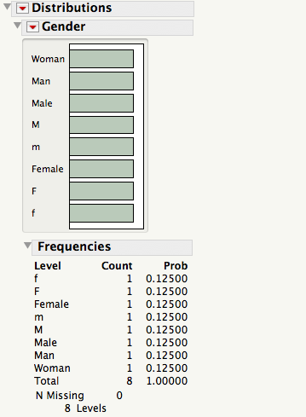
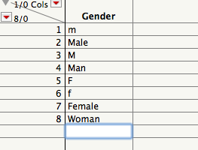
…and this is what happens when you try to analyze your SEX distribution in your population

Slide 95
Valid and Invalid Identifiers
If you run queries on your database to look for problems & outliers, you might get results such as this:
IDENTIFIER | VALID? | REASON IF INVALID
totalSales | Yes
total_Sales | Yes
total.Sales | No | Cannot contain .
4thQtrSales | No | Cannot begin with digit
totalSale$ | No | Cannot contain $

Slide 96
What do you mean and how will you record it?
So it’s important to know up front what specific information you are trying to collect, and how to ask in a way that your population understands.
HEADACHE
Headache
Pain in the head
ACHE:
Ache:Head
Head Pain
HP
Unless there is a standard code for the use of terms, data retrieval becomes difficult

Slide 97
Rules for Data Entry
Each variable has a field in the dataset
Categorical and nominal values require a number or string code
Continuous values are entered directly
Missing values must be different values from a real response
Common formats are “99” or bullets “·”
Don’t know is a response—do not leave blank
“0” is not the same as missing
Coding instructions should be on form
Avoid open-ended questions
These are important!

Slide 98
Avoid open-ended questions
Enter the subject’s gender:___________________
Enter the subject's level of education:__________

Slide 99
Close Ended Question
What is the subject’s sex? Check one
Male
Female

Slide 100
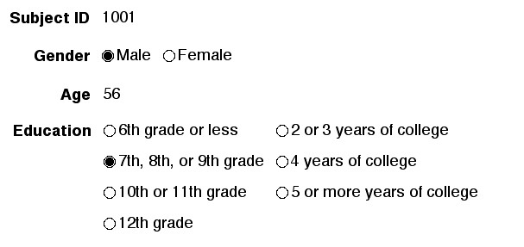
Use pre-coded responses where possible

Slide 101
Data Validation
The data you collect is going to need to go through the next steps of:

Slide 102
Data in Spreadsheet

Slide 103
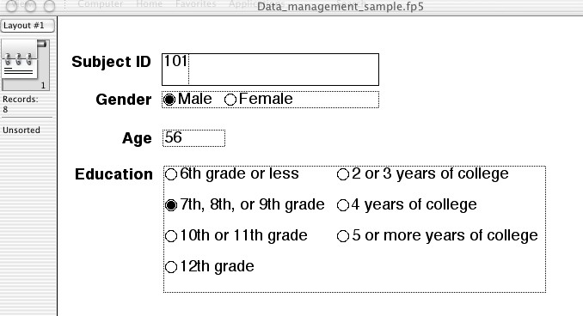
So this is how your database (data entry format) might appear:

Slide 104
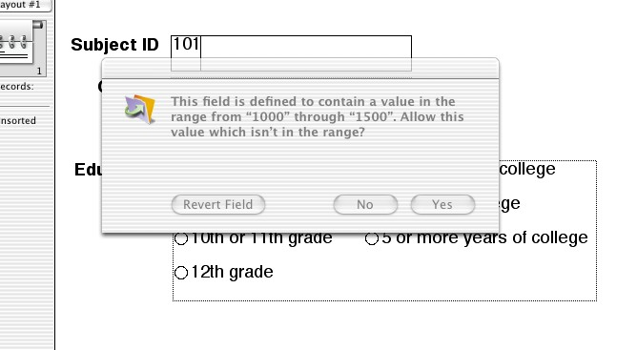
If you use a true DATABASE (not Excel) and have designed it appropriately, you – or whoever data-enters – will be stopped from entering something outside of the range that was specified.
Less time spent doing “data clean-up” and trying to track down errors means that you will be able to summarize and get to your results sooner.

Slide 105
Types of Edit Checks
Patient identification and record linkage
ID #’s, name spelling, ID#’s on all pages
Legibility
Correct form for examination
Missing data
Consistency
Range and inadmissible codes

Slide 106
Using computers (scan entry or direct entry) helps eliminate several steps in cleaning up the data.
Define data set, field names, codes
Data forms
Inspect data; hand edit
Enter data into computer
Scan
Technology
Data quality control
Check for missing, out-of-range, illogical responses
Accumulate in database
Data quality control
Backups
Transfer to statistical and presentation software
Do statistical analysis
Prepare graphs
and tables

Slide 107
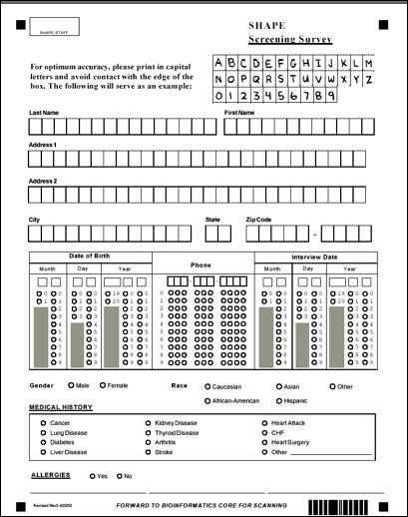
Digital Scanning Process
Data Form
Designer
Reader and
verifier
Data Form
Scanner
Database
Data
Editing

Slide 108
Similarly, reading values directly into the database from instruments minimizes data entry errors.
Define data set, field names, codes
Data forms
Acquire data directly from instrumentation
Inspect data; hand edit
Enter data into computer
Scan
Technology
Data quality control
Check for missing, out-of-range, illogical responses
Accumulate in database
Data quality control
Backups
Transfer to statistical and presentation software
Do statistical analysis
Prepare graphs
and tables

Slide 109
Data Acquired from Instruments
Massive amounts of data can be collected
Data management plan should consider interpretation (do I need all of it?), storage, and backup
Least opportunity for data recording and data entry errors
Data can be transferred by disk, Internet, e-mail, CD, DVD
May require editing by hand and additional processing before importing to study database

Slide 110
Relational Database
Relational databases enable organization of information based on “relationships” between the various data.
They consist of:
Tables describing an aspect of the database (e.g., subject demographic information, clinical findings, test results) containing...
Records holding data organized by one or more fields (e.g., name, address, phone).
Fields designed to hold various types of data (text, numbers, dates, etc.)
Elimination of Redundancy – a relational database does not repeat domain specific data in various tables. For example, imagine having to repeat a name (spelling, etc.) across several files; a relational database stores this information once and uses an identifier (e.g., SubjectId) to link information to test results, clinical findings, etc.
This "identification link" or key establishes relationships of data across various tables in a database so that data does not have to be repeated.

Slide 111
Relational Database Example
Subject Info
Anthropometrics
Id Name Age
10 Smith 50
11 Jones 55
12 Doe 60
ID Weight (lb) Weight (kg)
10 230 104.5
11 212 96.4
12 199 90.4
Physical Activity
Treadmill Performance
ID KCAL KCAL/kg
2400 23.1
2652 27.5
2350 25.9
ID V02 V02/kg
2.8 26.7
3.2 33.1
2.1 23.2

Slide 112
Advantages of a Relational Database
Elimination of Multiple Value Data – a relational database allows creation of relationships for subordinate data. For example, a table for laboratory testing and another table for clinical findings would each have multiple subjects but the subject demographic information is maintained in a separate table).
Avoiding Update Anomalies – since data is stored in only one place, it is easy to update (no other copies to remember to update).
Avoiding Data Entry Anomalies – like updates, since data is only stored in one place, it needs to be inserted in one place.
Avoiding Data Deletion Anomalies – once again, since data is in one place only, it is deleted only once.

Slide 113
Security of Research Records
Must be protected to ensure:
Protection of patient rights
Confidentiality of the data
Protection of the data itself from loss or corruption
Data must be kept in a locked file or a secure informatics system

Slide 114
Data Security
Patient confidentiality safeguards
Must comply with privacy guidelines
Patient name is coded or encrypted
Name kept in a separate file
Proscription against name, SSN or other identifiers in database
Misuse safeguards
Limit access to data files
Firewall, proxy servers
Files kept in locked areas
Store data on dedicated data server
Computer passwords
Loss safeguards
Duplicate of original study records
Backup

Slide 115
Backup
Data must be backed up on a regular basis to protect against:
Theft, fire, floods, hurricanes,
Equipment failure
Computer backup
Mirrored drives
Digital tapes
Store backup tapes off-site

Slide 116
Putting it All Together: Research Data Management
An artful selection of physical and electronic management methods
Signed informed consent documents
Paper forms
Regulatory and project management binders
Data models and databases
Data acquisition and display technologies
Communications technologies for project management as well as data management

Slide 117
Attributes of Successful Data Management
Attention to detail
Explicit structure and process
Robust designs
Anticipate failures, lapses and mistakes
Design systems that identify and correct them
Mechanisms for verification
Well documented

Slide 118
Quality
Fast is fine, but accuracy is everything.
(Wyatt Earp)

